Slide 1
Imposter Syndrome

Slide 2
Ever feel like a fake?

Slide 3
That you’re not sure you’re good enough to be a data scientist?

Slide 4
That so far you’ve only gotten by on luck, not talent?

Slide 5
Afraid you have to do it all alone, and you can’t?

Slide 6
Think you’re a smart cookie, but now aren’t sure, since you have to work at things for the first time?

Slide 7
Believe that your success so far is no big deal?

Slide 8


You’re Not Alone!
70% of Americans feel this way too!

Slide 9
Even Very Successful People Feel this Way!
Maya Angelou (author)
Howard Schultz (Starbucks exec)
Tina Fey (producer)
David Bowie (musician)
Serena Williams (tennis)
Tom Hanks (actor)
Sonia Sotomayor (supreme court justice)

Slide 10
I’ve felt this way!

Slide 11
Recognized by some large agencies…
NY Times
Harvard Business Review
American Psychological Association

Slide 12
What to do about it?

Slide 13
Talk it out!
We’re already talking now!
Discuss with your mentor or instructor
Check in with other students
Use your support network of family / friends

Slide 14
Celebrate yourself!
You may be different – look at that as a plus!
Be patient with yourself
Treat yourself with love and kindness

Slide 15
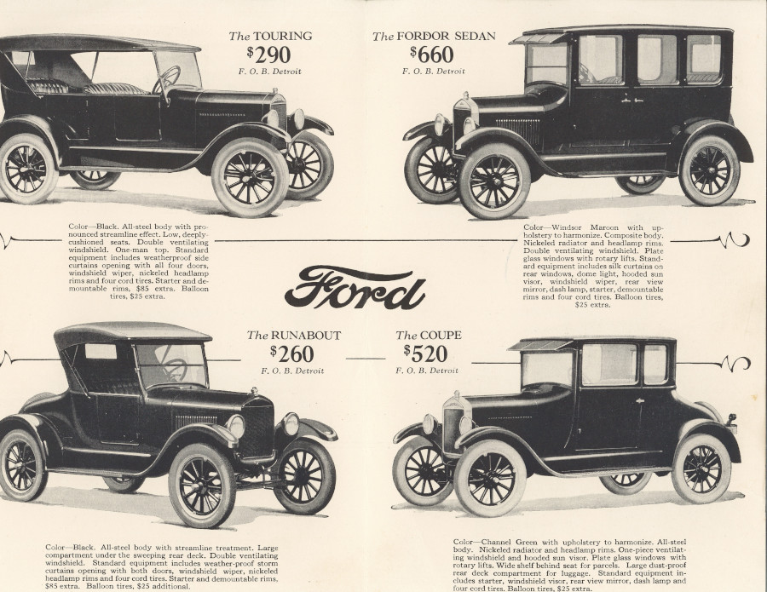
Revel in your Failure
“Failure is only the opportunity to begin again more intelligently.”
-Henry Ford

Slide 16
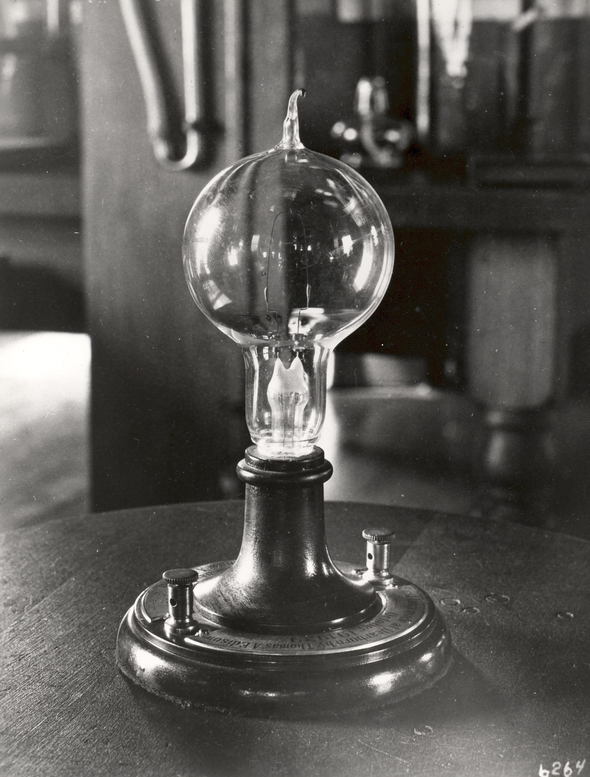
Revel in your Failure
Thomas Edison made 1,000 lightbulbs before it worked!

Slide 17
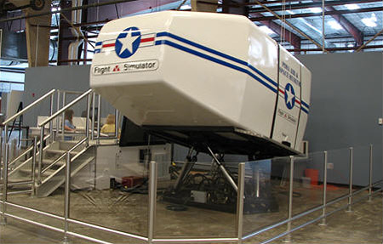
“There are no problems, Bob, just challenges and opportunities…”

Slide 18
Rage Against the Should Machine
Fight back statements like:
“I should know the answer”
“ I should not need to ask for help”
“I should be moving faster than this”
“I should understand this the first time”

Slide 19

Fake it ‘til you Make it!
You will make it
Just keep on chuggin’!

Slide 20
Questions? Comments?

